Slide 1

Chapter 2 Combinational systems
Definition: combinational logic, block, system
Logic gates and truth table
Don’t care condition
switching algebra (Boolean)
Complement
Functions with gates
2 - <number>

Slide 2
Digital logic circuits
Digital circuits: hardware components that manipulate binary information
Logic gates implement logic functions.
Basic logical operators are the logic functions AND, OR and NOT
Boolean Algebra: a useful mathematical system for specifying and transforming logic functions.
We study Boolean algebra as a foundation for designing and analyzing digital systems!
Hierarchical design: circuit design hierarchy (Y-chart)
Basic circuit element can be
  Transistor
  Logic gate
  Wire
2 - <number>

Slide 3
Levels of abstractions
Level
Behavioral
forms
Structural
components
Physical
objects
Transistor
differential equations,
current-voltage
diagrams
transistors,
resistors, capacitors
analog and digital cells
Gate
Boolean equations,
finite state machines
gates, flip-flops
modules, units
Register
algorithms, flowcharts,
instruction sets
adders, registers,
counters, queues
microchips
Processor
executable specification,
programs
processors, controllers, memories
printed-circuit boards, multichip modules
2 - <number>

Slide 4
Y chart
BEHAVIORAL DOMAIN
STRUCTURAL DOMAIN
system
processor
algorithm
ALU, RAM
register transfer
gates, flip-flop
logic
transfer functions
transistor
transistor layout
cell layout
module layout
floorplan
physical partition
PHYSICAL DOMAIN
2 - <number>

Slide 5
Logical operations
The three basic logical operations are:
  AND
  OR
  NOT
AND is denoted by a dot (·)
OR is denoted by a plus (+)
NOT is denoted by an overbar ( ¯ ), a single quote mark (') after, or (~) before the variable
Examples:
  Y = A x B is read “Y is equal to A AND B.”
  Z = X + Y is read “z is equal to x OR y.”
  X = ~A is read “X is equal to NOT A.”
Note: The statement:
  1 + 1 = 2 (read “one plus one equals two”)
is not the same as
  1 + 1 = 1 (read “1 or 1 equals 1”)
2 - <number>

Slide 6
Operator definition
Operations are defined on the values "0" and "1" for each operator:
AND
OR
NOT
0 · 0 = 0
0 + 0 = 0
=
0
1
0 · 1 = 0
0 + 1 = 1
=
1
0
1 · 0 = 0
1 + 0 = 1
1 · 1 = 1
1 + 1 = 1
2 - <number>

Slide 7
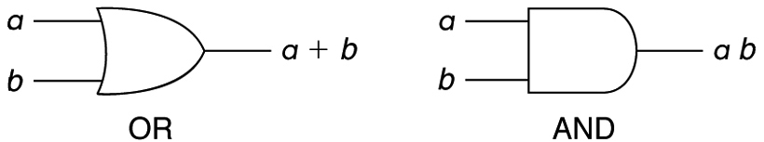
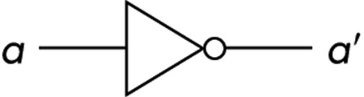
Truth table
Truth table - a tabular listing of the values of a function for all possible combinations of values on its arguments
Example: Truth tables for the basic logic operations:
symbols
A B | C = A + B
0 0 0 1 1 0 1 1 | 0 1 1 1
A B | C = A · B
0 0 0 1 1 0 1 1 | 0 0 0 1
A | C = ~A
0 1 | 1 0
NOT
2 - <number>

Slide 8
Logic function implementation
Using Switches
  For inputs:
    logic 1 is switch closed
    logic 0 is switch open
  For outputs:
    logic 1 is light on
    logic 0 is light off.
  NOT uses a switch such
  that:
    logic 1 is switch open
    logic 0 is switch closed
Switches in parallel => OR
Switches in series => AND
Normally-closed switch => NOT
C
2 - <number>

Slide 9
Logic Diagrams and Expressions
Truth Table
Equation
X Y Z
F
=
X
+
Y
⋅
Z
F
=
X
+
Y
Z
0 0 0
0
0 0 1
1
0 1 0
0
Logic Diagram
0 1 1
0
X
1 0 0
1
Y
F
1 0 1
1
1 1 0
1
Z
1 1 1
1
Boolean equations, truth tables and logic diagrams describe the same function!
Truth tables are unique; expressions and logic diagrams are not. This gives flexibility in implementing functions.
2 - <number>

Slide 10









Basic logic library
GRAPHIC FUNCTIONAL COST(NUMBER GATE Truth
NAME SYMBOL EXPRESSION OF TRANSISTORS) DELAY(NS) table
Inverter F = x’ 2 1
x F
0 1
1 0
Driver F = x 4 2
x F
0 0
1 1
x y F
0 0 0
0 1 0
1 0 0
1 1 1
AND F = xy 6 2.4
x y F
0 0 0
0 1 1
1 0 1
1 1 1
OR F = x+y 6 2.4
x y F
0 0 1
0 1 1
1 0 1
1 1 0
NAND F = (xy)’ 4 1.4
x y F
0 0 1
0 1 0
1 0 0
1 1 0
NOR F = (x+y)’ 4 1.4
x y F
0 0 0
0 1 1
1 0 1
1 1 0
XOR F = x⊕y 14 4.2
x y F
0 0 1
0 1 0
1 0 0
1 1 1
XNOR F = xy 12 3.2
2 - <number>

Slide 11
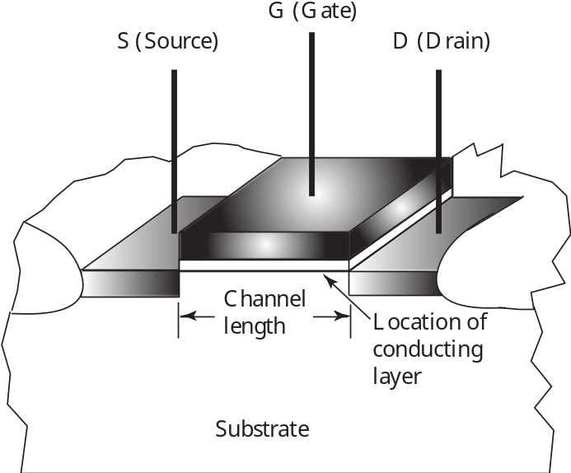
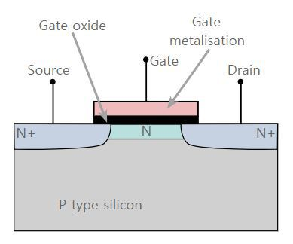
MOS Transistor
7 - <number>

Slide 12
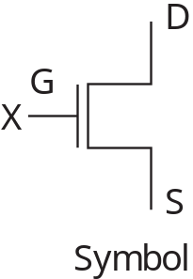
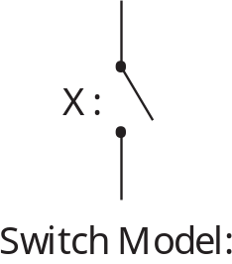
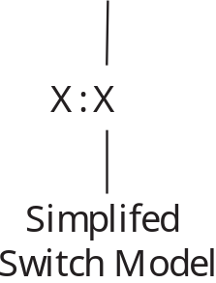
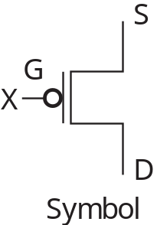
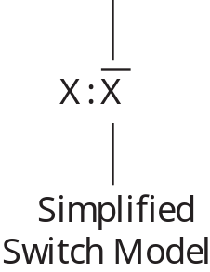
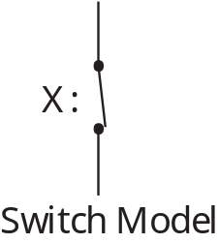
Switch Models for MOS Transistors
n-Channel – Normally Open (NO) Switch Contact
p-Channel – Normally Closed (NC) Switch Contact
7 - <number>

Slide 13
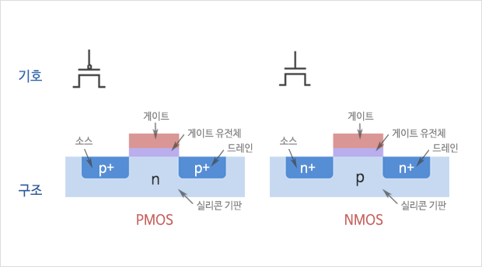
transistor
2 - <number>

Slide 14
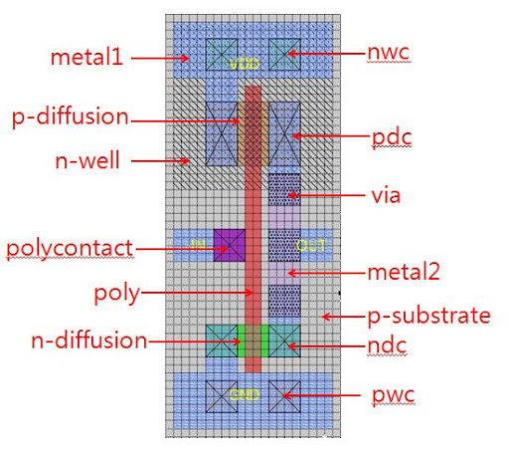
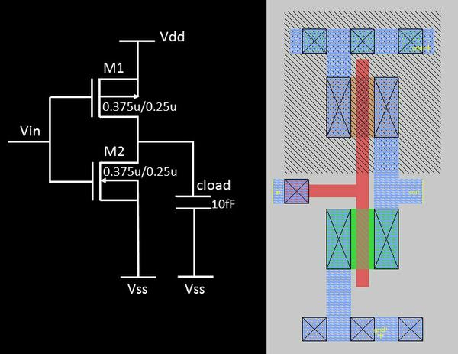
Inverter Layout
2 - <number>

Slide 15
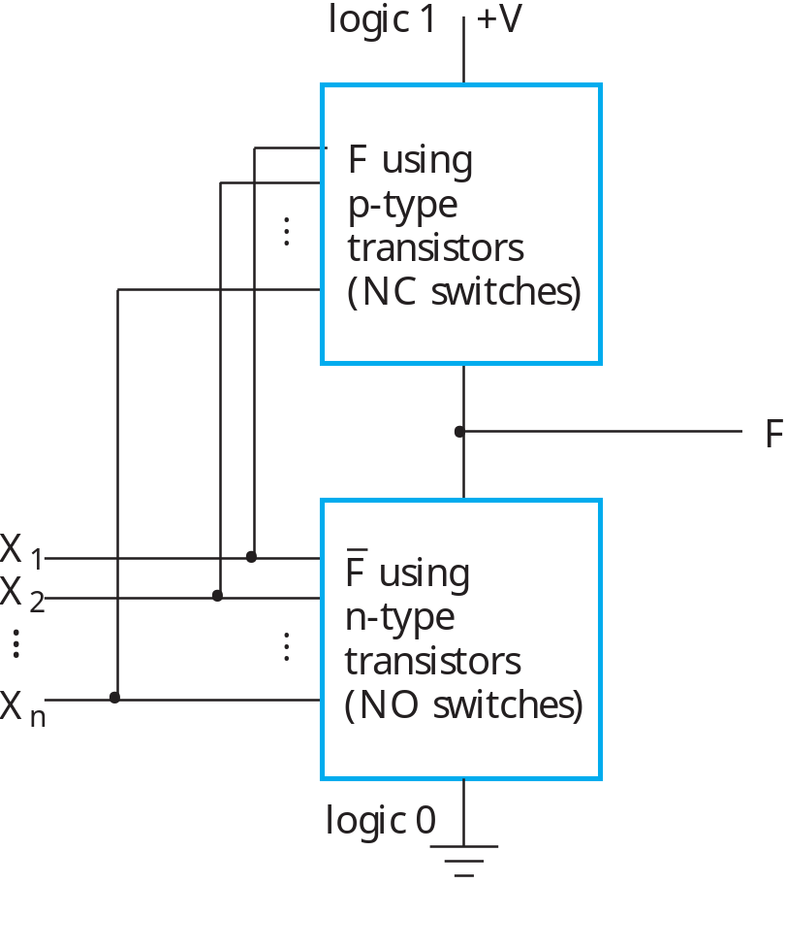
Fully-Complementary CMOS Circuit
Circuit structure for fully-complementary CMOS gate
7 - <number>

Slide 16
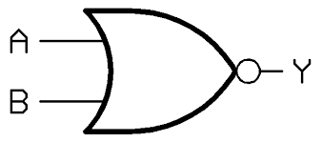
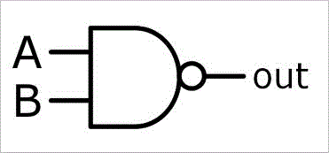
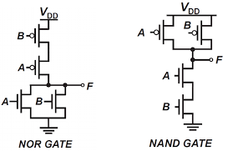
NOR, NAND gates
2 - <number>

Slide 17
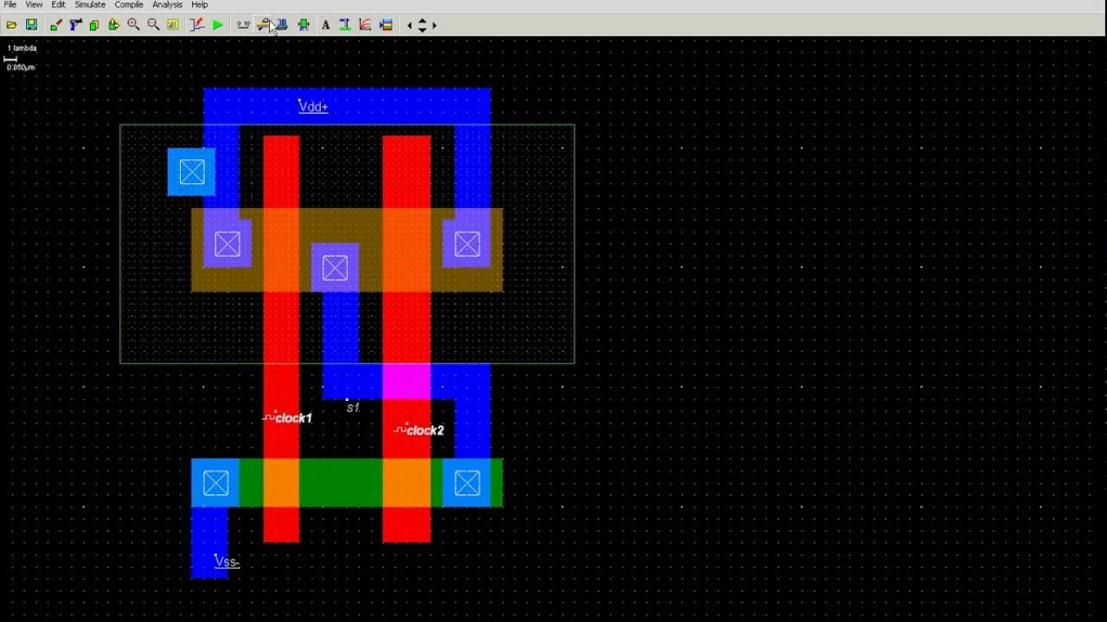
2-input NAND layout
2 - <number>

Slide 18
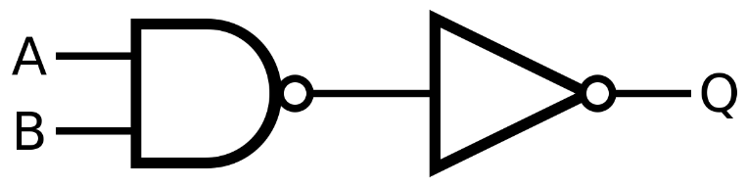
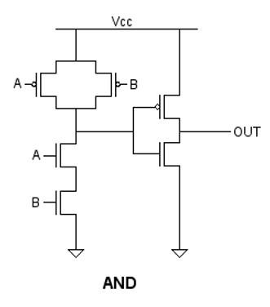
AND gate
2 - <number>

Slide 19
Design process
Design process is a sequence of steps which leads from a product concept to manufacturing drawings that show how to build that product
Computer design
  Server, desktop, embedded
System design
ASIC (application specific integrated circuit)
IP blocks (processor, memory, I/O, control units)
2 - <number>

Slide 20
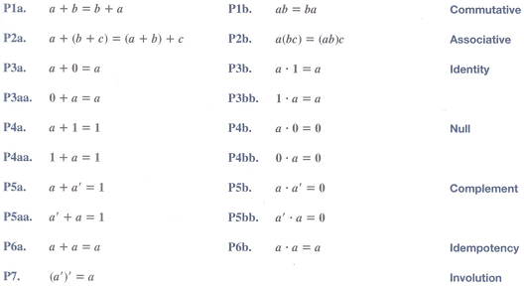
Switching algebra
2 - <number>

Slide 21
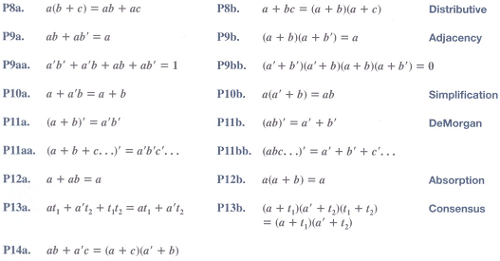
Switching algebra
2 - <number>

Slide 22
Example 1: Boolean Algebraic Proof
A + A·B = A (Absorption Theorem)
Proof Steps Justification (identity or theorem)
A + A·B
= A · 1 + A · B X = X · 1
= A · ( 1 + B) X · Y + X · Z = X ·(Y + Z)(Distributive Law)
= A · 1 1 + X = 1
= A X · 1 = X
Our primary reason for doing proofs is to learn:
  Careful and efficient use of the identities and theorems of Boolean algebra, and
  How to choose the appropriate identity or theorem to apply to make forward progress, irrespective of the application.
2 - <number>

Slide 23
Example 2: Boolean Algebraic Proofs
AB + A’C + BC = AB + A’C (Consensus Theorem)
Proof Steps Justification (identity or theorem)
AB + AC’ + BC
= AB + AC’ + 1 · BC 1 . X = X
= AB +AC’ + (A + A’) · BC X + X’ = 1
= AB + A’C + ABC + A’BC X(Y + Z) = XY + XZ (Distributive Law)
= AB + ABC + A’C + A’BC X + Y = Y + X (Commutative Law)
= AB . 1 + ABC + A’C . 1 + A’C . B X . 1 = X, X . Y = Y . X (Commutative Law)
= AB (1 + C) + A’C (1 + B) X(Y + Z) = XY +XZ (Distributive Law)
= AB . 1 + A’C . 1
= AB + A’C X . 1 = X
2 - <number>
Notes:
Justification 1: 1 . X = X
Justification 2: X + X’ = 1
= AB + A’C + ABC + A’BC X(Y + Z) = XY + XZ (Distributive Law)
= AB + ABC + A’C + A’BC X + Y = Y + X (Commutative Law)
= AB . 1 + ABC + A’C . 1 + A’C . B X . 1 = X, X . Y = Y . X (Commutative Law)
= AB (1 + C) + A’C (1 + B) X(Y + Z) = XY +XZ (Distributive Law)
= AB . 1 + A’C . 1 = AB + A’C X . 1 = X

Slide 24
Example 3: Boolean Algebraic Proofs
(X+Y)’Z+XY’ = Y’(X+Z)
proof steps Justification
= X’ Y’ Z + X Y’ (A + B)’ = A’ . B’ (DeMorgan’s Law)
= Y’ X’ Z + Y’ X A . B = B . A (Commutative Law)
= Y’ (X’ Z + X) A(B + C) = AB + AC (Distributive Law)
= Y’ (X’ + X)(Z + X) A + BC = (A + B)(A + C) (Distributive Law)
= Y’ . 1 . (Z + X) A + A’ = 1, 1 . A = A
= Y’ (X + Z), A + B = B + A (Commutative Law)
2 - <number>
Notes:
= X’ Y’ Z + X Y’ (A + B)’ = A’ . B’ (DeMorgan’s Law)
= Y’ X’ Z + Y’ X A . B = B . A (Commutative Law)
= Y’ (X’ Z + X) A(B + C) = AB + AC (Distributive Law)
= Y’ (X’ + X)(Z + X) A + BC = (A + B)(A + C) (Distributive Law)
= Y’ . 1 . (Z + X) A + A’ = 1
= Y’ (X + Z) 1 . A = A, A + B = B + A (Commutative Law)

Slide 25
Proof of DeMorgan’s Laws
(x+y)’ = x’y’
It is important that we do not USE DeMorgan’s Laws in doing this proof.
This requires a different proof method. We will show that, x’ . y’, satisfies
the definition of the complement of (x + y), defined as (x + y)’ by DeMorgan’s Law. To show this we need to show that A + A’ = 1 and A.A’ = 0 with
A = x + y and A’ = x’. y’. This proves that x’. y’ = (x + y)’.
Part 1: Show x + y + x’. y’ = 1.
x + y + x’. y’
= (x + y + x’) (x + y + y’) X + YZ = (X + Y)(X + Z) (Distributive Law)
= (x + x’ + y) (x + y + y’) X + Y = Y + X (Commutative Law)
= (1 + y)(x + 1) X + X’ = 1
= 1 . 1 1 + X = 1
= 1 1 . X = 1
Part 2: Show (x + y) . x’. y’ = 0.
(x + y) . x’. y’
= (x . x’. y’ + y . x’. y’) X (Y + Z) = XY + XZ (Distributive Law)
= (x . x’. y’ + y . y’ . x’) XY = YX (Commutative Law)
= (0 . y’ + 0 . x’) X . X’ = 0
= (0 + 0) 0 . X = 0
= 0 X + 0 = X (With X = 0)
2 - <number>

Slide 26
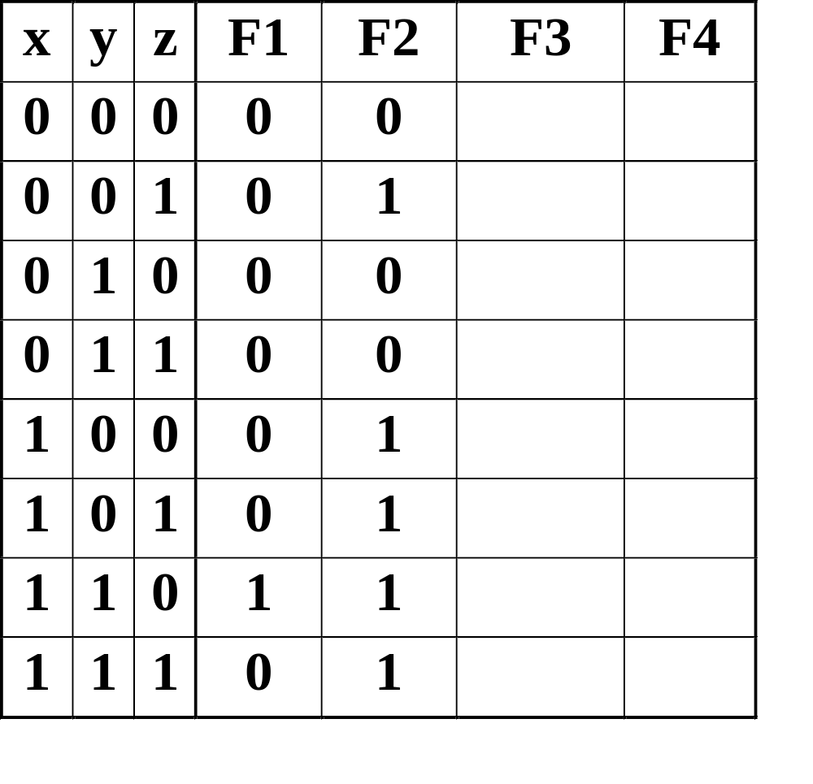
Boolean Function Evaluation
F1
=
xy
z
F2
=
x
+
y
z
F3
=
x
y
z
+
x
y
z
+
x
y
F4
=
x
y
+
x
z
2 - <number>

Slide 27
Expression Simplification
An application of Boolean algebra
Simplify to contain the smallest number of literals (complemented and uncomplemented variables):
= AB + ABCD + A’CD + A’CD’ + A’BD
= AB + AB(CD) + A’C (D + D’) + A’BD
= AB + A’C + A’BD
= B(A + A’D) +A’C
= B (A + D) + A’C 5 literals
A
B
+
A
C
D
+
A
B
D
+
A
C
D
+
A
B
C
D
2 - <number>

Slide 28
Complementing Functions
Use DeMorgan's Theorem to complement a function:
  1. Interchange AND and OR operators
  Complement each constant value and literal
Examples
  Complement F = x’yz’ + xy’z’
  Complement G = (a’ + bc)d’ + e
  G' = ((a (b' + c'))+ d ) e' = (a (b' + c') + d) e'
2 - <number>
Notes:
G' = ((a (b' + c'))+ d ) e' = (a (b' + c') + d) e'

Slide 29
Complement example
Example 2.5
  F = wx’y + xy’ + wxz
  F’ =
Example 2.6
f = ab’(c + d’e) + a’bc’
  f’ = [ab’(c + d’e) + a’bc’]’ using [P11a], [P11b]
  = [ab’(c + d’e)]’[a’bc’]’
  = [a’ + b + (c + d’e)’][a + b’ + c]
  = [a’ + b + c’(d’e)’][a + b’ + c]
  = [a’ + b + c’(d + e’)][a + b’ + c]
2 - <number>

Slide 30


Boolean Functions
Truth Table for F1 = xy +xy’z +x’yz
its Complement F1’ = (x’+y’)(x’+y+z’)(x+y’+z’)
VARIABLE
VALUES
FUNCTION
VALUES
ex) F1 = 1
x=1 and y=1, or if x=1, y=0, and z=1,
or if x=0, y=1, and z=1.
ROW
NUMBER
x y z
F1 F1’
0
1
2
3
4
5
6
7
0 0 0
0 0 1
0 1 0
0 1 1
1 0 0
1 0 1
1 1 0
1 1 1
0 1
0 1
0 1
1 0
0 1
1 0
1 0
1 0
As a general rule, the truth table
for any Boolean function of n variable
has rows.
2 - <number>

Slide 31
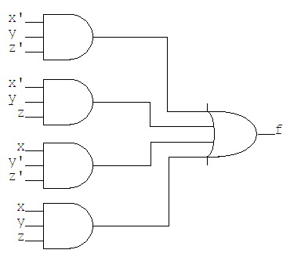
Implementation of Functions with AND, OR, and NOT Gates
Block diagram
f = x′yz′ + x′yz + xy′z′ + xy′z + xyz
Block diagram of f in sum of standard products form.
Figure 2.7 in text
2 - <number>

Slide 32



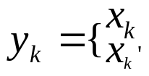









Canonical Forms - Minterm
Minterm
Let i = be a binary number
A minterm of variables
if bk =1 all k
if bk=0
x y z
MINTERMS
NOTATION
All minterms of the three binary variables,
x,y, and z
0 0 0
0 0 1
0 1 0
0 1 1
1 0 0
1 0 1
1 1 0
1 1 1
x’y’z’
x’y’z
x’yz’
x’yz
xy’z’
xy’z
xyz’
xyz
2 - <number>

Slide 33



Canonical Forms - Minterm
F1 = = x’yz+xy’z+xyz’+xyz 1-minterms
F1’ = = x’y’z’+x’y’z+x’yz’+xy’z’ 0-minterms
An important property of Boolean algebra :
Any Boolean function can be expressed as a sum of its 1-minterms.
Sum-of-minterms form
F (list of variables) = (list of 1-minterm indices)
ex) F1(x,y,z) = (3,5,6,7)
F1’(x,y,z) = (0,1,2,4)
2 - <number>

Slide 34

Sum of minterm expressions
EXAMPLE 3.1 Sum-of-minterms expansion
PROBLEM Express the Boolean function F=x+yz as a sum of minterms
SOLUTION
F = x+yz
= x(y+y’)(z+z’)+(x+x’)yz
= xyz+xy’z+xyz’+xy’z’+xyz+x’yz
After removing duplicates,
F = x’yz+xy’z’+xy’z+xyz’+xyz
=
= (3,4,5,6,7)
Truth Table for
F = x + yz
x y z
F
EXAMPLE 3.2 Conversion to a sum of minterms
PROBLEM Convert the Boolean function F=x+yz into
a sum of minterms by using a truth table.
(Table 3.10)
0 0 0
0 0 1
0 1 0
0 1 1
1 0 0
1 0 1
1 1 0
1 1 1
0
0
0
1
1
1
1
1
SOLUTION
F =
2 - <number>

Slide 35


Canonical Forms - Maxterm
Eight maxterms of the three binary
variables, x,y, and z
x y z
MAXTERMS
NOTATION
0 0 0
0 0 1
0 1 0
0 1 1
1 0 0
1 0 1
1 1 0
1 1 1
x + y + z
x + y + z’
x + y’ + z
x + y’ + z’
x’ + y + z
x’ + y + z’
x’ + y’ + z
x’ + y’ + z’
M₀
M₁
M₂
M₃
M₄
M₅
M₆
M₇
The expression for F1=x’yz+xy’z+xyz’+xyz
(F1)’ = (x’yz+xy’z+xyz’+xyz)’
= (x+y’+z’)(x’+y+z’)(x’+y’+z)(x’+y’+z’)
=
Similarly, by complementing the expression
F1 = (F1’)’
= (x’y’z’+x’y’z+x’yz’+xy’z’)’
= (x+y+z)(x+y+z’)(x+y’+z)(x’+y+z)
=
2 - <number>

Slide 36

Product of maxterm
An second unique property of Boolean algebra :
Any Boolean function can be expressed as a product of its 0-maxterms.
Product of maxterms form
F (list of variables) = (list of 0-maxterm indices)
A general conversion procedure to convert from on canonical form to another,
interchange the symbols and , and list the numbers that were excluded
from the original form.
EXAMPLE 3.3 Product-of-maxterms expansion
PROBLEM Derive the product-of-maxterms form for the Boolean function
F=x’y’+xz
SOLUTION
F = x’y’+xz
= (x’y’+x)(x’y’+z)
= (x’+x)(y’+x)(x’+z)(y’+z)
= (x+y’)(x’+z)(y’+z)
2 - <number>

Slide 37



Product of maxterm
into two maxterms
x+y’= x+y’+zz’ = (x+y’+z)(x+y’+z’)
x’+z = x’+z+yy’ = (x’+y+z)(x’+y’+z)
y’+z = y’+z+xx’ = (x+y’+z)(x’+y’+z)
Finally,
F = (x+y’+z)(x+y’+z’)(x’+y+z)(x’+y’+z)
= = (2,3,4,6)
Truth Table for
F = x’y’ + xz
EXAMPLE 3.4 Conversion to product of maxterms
PROBLEM Convert the Boolean function F= x’y’+xz
into the product-of-maxterms form.
SOLUTION
F(x,y,z) = (0,1,5,7)
minterms from Table
F(x,y,z) = (2,3,4,6)
the missing minterms
x y z
F
0 0 0
0 0 1
0 1 0
0 1 1
1 0 0
1 0 1
1 1 0
1 1 1
1
1
0
0
0
1
0
1
2 - <number>

Slide 38
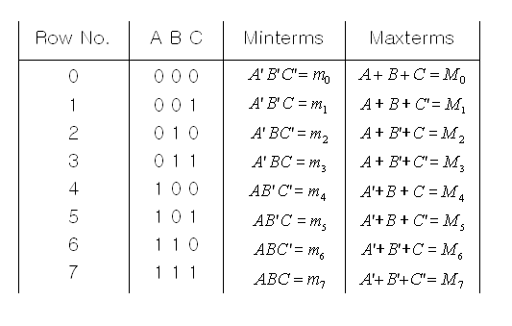
Minterm and Maxterm Expansions
3 variables
2 - <number>

Slide 39
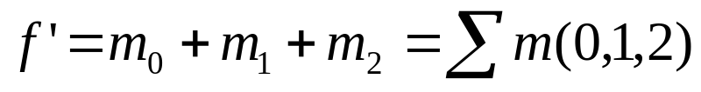


Minterm and Maxterm Expansions
- Minterm and Maxterm expansions are complement each other
2 - <number>

Slide 40
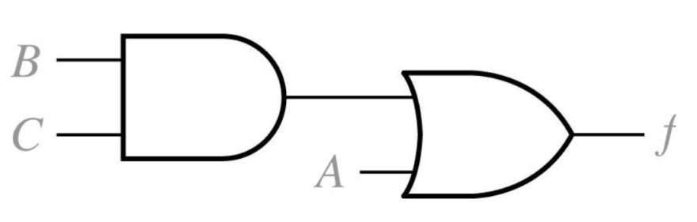
Combinational Logic Design Using a Truth Table
Original equation →
Simplified equation →
Circuit realization →
2 - <number>

Slide 41

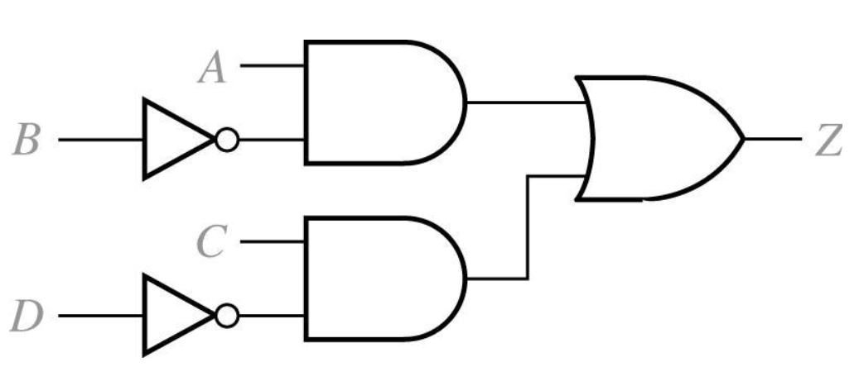
Conversion of English Sentences to Boolean Equations
1. The alarm will ring(Z) iff the alarm switch is turned on(A) and the door is not closed(B’), or it is after 6PM(C) and window is not closed(D’)
2. Boolean Equation
3. Circuit realization
2 - <number>

Slide 42
From The Truth Table to Algebraic Expressions
Truth table
  To find a minimum POS expression
    Manipulate the previous POS expression to obtain f = (A + B + C)(A’ + B’)
    Simplify the SOP expression for f’ and then use DeMorgan to convert it to a POS expression.
    Both approaches produce the same result.
  How many different functions of n variables are there?
a | b | f0 | f1 | f2 | f3 | f4 | f5 | f6 | f7 | f8 | f9 | f10 | f11 | f12 | f13 | f14 | f15
0 | 0 | 0 | 0 | 0 | 0 | 0 | 0 | 0 | 0 | 1 | 1 | 1 | 1 | 1 | 1 | 1 | 1
0 | 1 | 0 | 0 | 0 | 0 | 1 | 1 | 1 | 1 | 0 | 0 | 0 | 0 | 1 | 1 | 1 | 1
1 | 0 | 0 | 0 | 1 | 1 | 0 | 0 | 1 | 1 | 0 | 0 | 1 | 1 | 0 | 0 | 1 | 1
1 | 1 | 0 | 1 | 0 | 1 | 0 | 1 | 0 | 1 | 0 | 1 | 0 | 1 | 0 | 1 | 0 | 1
Variables | Terms
1 | 4
2 | 16
3 | 256
4 | 65,536
5 | 4,294,967,296
Number of functions of n variables
2 - <number>

Slide 43

Other logic operations
FUNCTION
OPERATOR VALUES FOR x,y= ALGEBRAIC
NAME SYMBOL 00 01 10 11 EXPRESSION COMMENT
Zero 0 0 0 0 F0 = 0 Binary constant 0
AND x • y 0 0 0 1 F1 = xy x and y
Inhibition x/y 0 0 1 0 F2 = xy’ x but not y
Transfer 0 0 1 1 F3 = x x
Inhibition y/x 0 1 0 0 F4 = x’y y but not x
Transfer 0 1 1 1 F5 = y y
XOR x⊕y 0 1 1 0 F6 = xy’+x’y x or y but not both
OR x+y 0 1 1 1 F7 = x+y x or y
NOR x↓y 1 0 0 0 F8 = (x+y)’ Not-OR
Equivalence xy 1 0 0 1 F9 = xy+x’y’ x equals y
Complement y’ 1 0 1 0 F10 = y’ Not y
Implication x⊂y 1 0 1 1 F11 = x+y’ If y, then x
Complement x’ 1 1 0 0 F12 = x’ Not x
Implication x⊃y 1 1 0 1 F13 = x’+y If x, then y
NAND x↑y 1 1 1 0 F14 = (xy)’ Not-AND
One 1 1 1 1 F15 = 1 Binary constant 1
Boolean Expressions for the 16 Functions of Two Variables
2 - <number>

Slide 44
Basic logic library
GRAPHIC FUNCTIONAL COST(NUMBER GATE Truth
NAME SYMBOL EXPRESSION OF TRANSISTORS) DELAY(NS) table
Inverter F = x’ 2 1
x F
0 1
1 0
Driver F = x 4 2
x F
0 0
1 1
x y F
0 0 0
0 1 0
1 0 0
1 1 1
AND F = xy 6 2.4
x y F
0 0 0
0 1 1
1 0 1
1 1 1
OR F = x+y 6 2.4
x y F
0 0 1
0 1 1
1 0 1
1 1 0
NAND F = (xy)’ 4 1.4
x y F
0 0 1
0 1 0
1 0 0
1 1 0
NOR F = (x+y)’ 4 1.4
x y F
0 0 0
0 1 1
1 0 1
1 1 0
XOR F = x⊕y 14 4.2
x y F
0 0 1
0 1 0
1 0 0
1 1 1
XNOR F = xy 12 3.2
2 - <number>

Slide 45





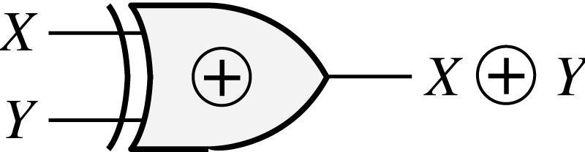
Exclusive-OR and Equivalence Operations
Exclusive-OR
Truth Table
XY
0 0
0 1
1 0
1 1
0
1
1
0
Symbol
2 - <number>

Slide 46




Exclusive-OR and Equivalence Operations
Theorems for Exclusive-OR:
2 - <number>

Slide 47
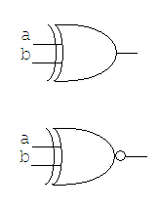
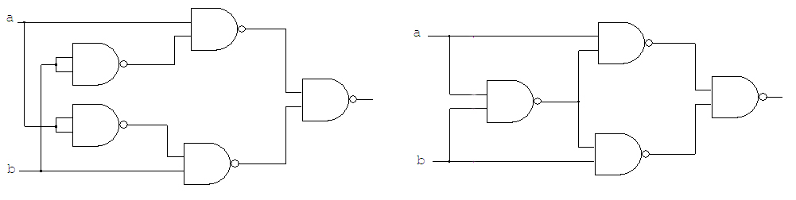
NAND, NOR, AND EXCLUSIVE-OR GATES
Three other gates
Exclusive-OR gates.
An Exclusive-OR gate
An Exclusive-NOR gate
Exclusive-OR gate implements the expression
  (a b) = a’b + ab’
  (a b)’ = a’b’ + ab
2 - <number>

Slide 48
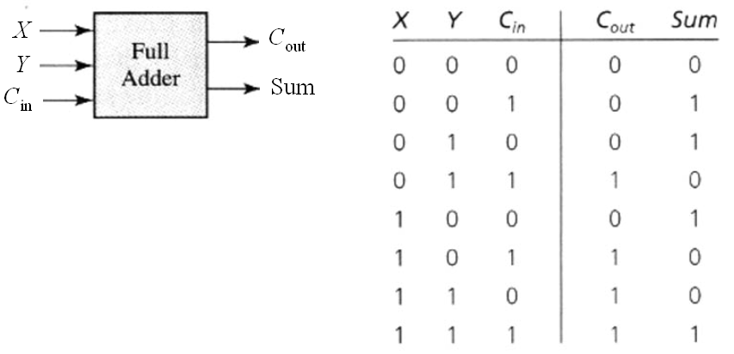
Binary Adders and Subtracters
Truth Table for a Full Adder
2 - <number>

Slide 49
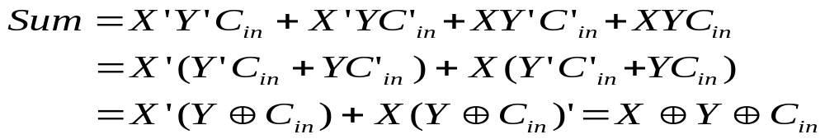
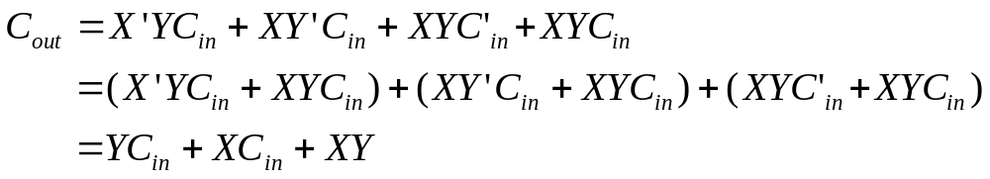
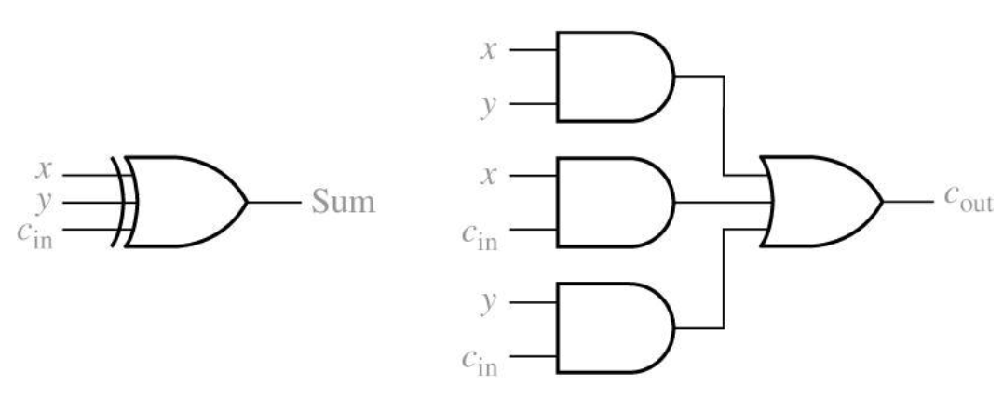
Full adder
2 - <number>

Slide 50


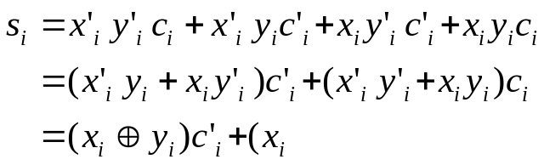





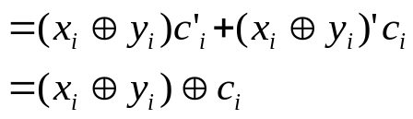
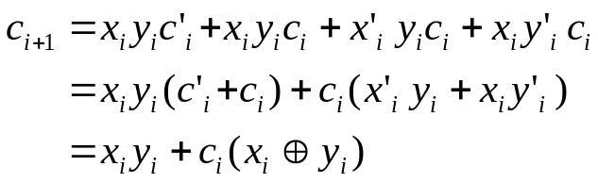
Full adder design
EXAMPLE Full-adder design
PROBLEM Design a full adder based on the specifications given in table,
using the basic logic library that was given in Table.
The primary goal is to minimize the propagation delay from to ,
while the secondary goal is to use the smallest possible number of transistors.
SOLUTION
Addition of Binary
Digits
0 0 0
0 0 1
0 1 0
0 1 1
1 0 0
1 0 1
1 1 0
1 1 1
0 0
0 1
0 1
1 0
0 1
1 0
1 0
1 1
2 - <number>

Slide 51


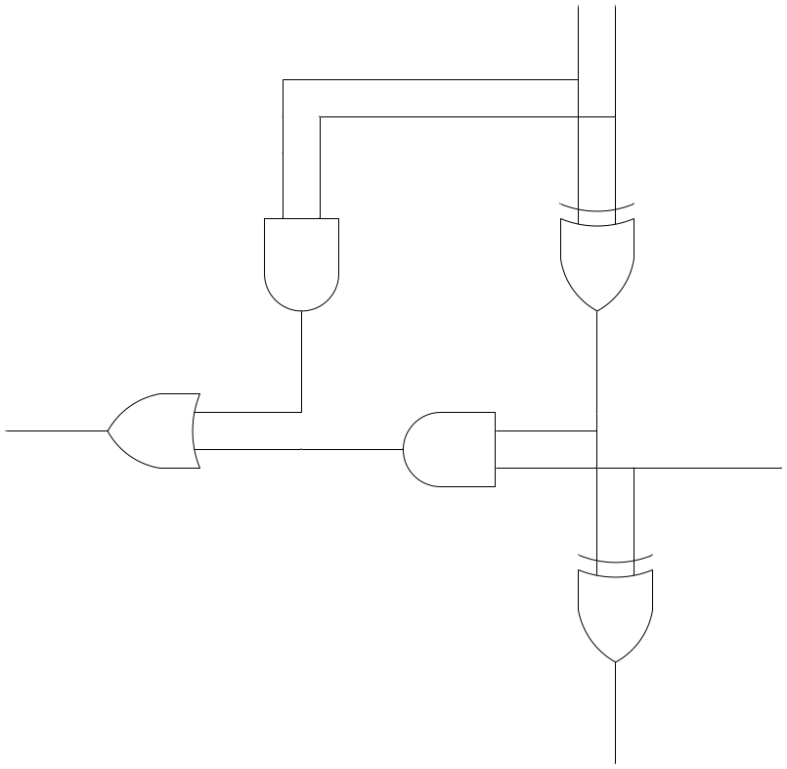
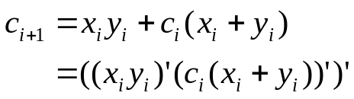







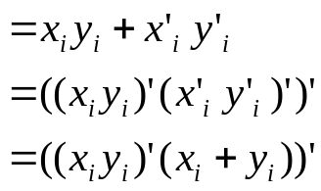

Full adder design
2B - 42
Modify the expression (faster, less expensive NAND and NOR gates)
De Morgan’s theorems :
In addition, with two NANDs and one OR gates :
2 - <number>

Slide 52
A seven-segment display
The Development of Truth Tables
a
b
c
d
e
f
g
W
a
f
b
X
Display Driver
g
Y
e
c
Z
d
2 - <number>

Slide 53
Truth table for seven segment display
The Development of Truth Tables
Digit | W | X | Y | Z | a | b | c | d | e | f | g
0 | 0 | 0 | 0 | 0 | 1 | 1 | 1 | 1 | 1 | 1 | 0
1 | 0 | 0 | 0 | 1 | 0 | 1 | 1 | 0 | 0 | 0 | 0
2 | 0 | 0 | 1 | 0 | 1 | 1 | 0 | 1 | 1 | 0 | 1
3 | 0 | 0 | 1 | 1 | 1 | 1 | 1 | 1 | 0 | 0 | 1
4 | 0 | 1 | 0 | 0 | 0 | 1 | 1 | 0 | 0 | 1 | 1
5 | 0 | 1 | 0 | 1 | 1 | 0 | 1 | 1 | 0 | 1 | 1
6 | 0 | 1 | 1 | 0 | X | 0 | 1 | 1 | 1 | 1 | 1
7 | 0 | 1 | 1 | 1 | 1 | 1 | 1 | 0 | 0 | X | 0
8 | 1 | 0 | 0 | 0 | 1 | 1 | 1 | 1 | 1 | 1 | 1
9 | 1 | 0 | 0 | 1 | 1 | 1 | 1 | X | 0 | 1 | 1
- | 1 | 0 | 1 | 0 | X | X | X | X | X | X | X
- | 1 | 0 | 1 | 1 | X | X | X | X | X | X | X
- | 1 | 1 | 0 | 0 | X | X | X | X | X | X | X
- | 1 | 1 | 0 | 1 | X | X | X | X | X | X | X
- | 1 | 1 | 1 | 0 | X | X | X | X | X | X | X
- | 1 | 1 | 1 | 1 | X | X | X | X | X | X | X
2 - <number>

